Slide 1
Cesare Lombroso and his theory

Slide 2
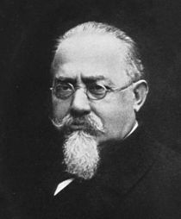
Cesare Lombroso (1835 – 1909) was an Italian criminologist, physician, and founder of the Italian School of Positivist Criminology.
Born in Verona Cesare Lombroso studied medicine at the universities of Pavia, Padua, Vienna, and Genoa.
His interests in psychology and psychiatry merged with his study of the physiology and anatomy of the brain and ultimately led to his anthropometric analysis of criminals.
While he was in charge of the insane at hospitals in Pavia, Pesaro, and Reggio Emilia (1863-1872), his interest in physiognomical characteristics of the mentally disturbed increased.

Slide 3
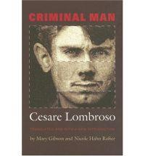
In 1876 Lombroso became professor of legal medicine and public hygiene at the University of Turin. That year he wrote his most important and influential work, “L'uomo delinquent” (1876; “The Criminal Man”), which went through five editions in Italian and was published in various European languages but never in English.
Lombroso devised the theory that criminality is determined by physiological traits. Called The father of modern criminology, he concentrated attention on the study of the individual offender.

Slide 4

Lombroso published ”The Man of Genius” ( 1889), a book which argued that artistic genius was a form of hereditary insanity. In order to support this statement, he began assembling a large collection of "psychiatric art". He published an article on the subject in 1880 in which he isolated thirteen typical features of the "art of the insane."

Slide 5
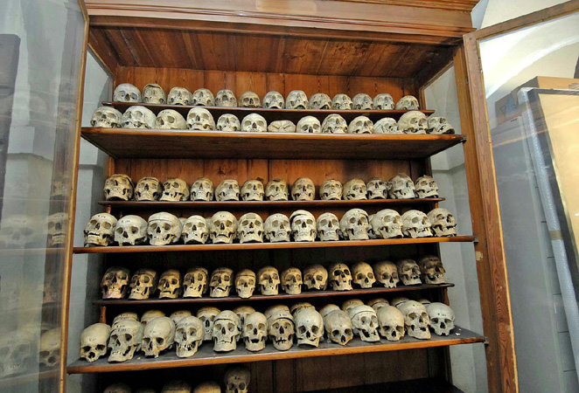
From 1866 onwards, the year in which he began to work as a military doctor, Cesare Lombroso collected skulls, skeletons, brains and various other types of objects, which formed the core collection of a private museum, first housed at his home in Turin.

Slide 6
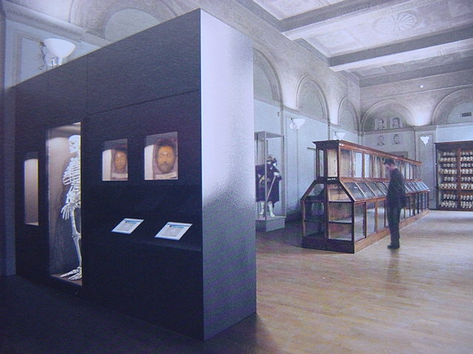
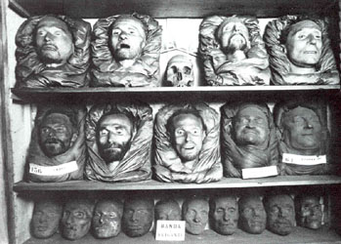
Later was founded Lombroso’s Museum (Museum of Criminal Anthropology), which had been allocated more exhibition space by the University of Turin, and it accorded scientific status.

Slide 7
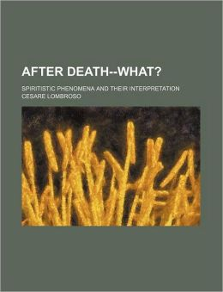
Later in his life Lombroso began investigating psychic phenomena and spiritualism. Although originally sceptical, he later became a believer in spiritualism.
As an atheist, Lombroso discusses his views on spiritualism and the paranormal in his book “After Death – What? (1909)”.
In the book he admitted that he was a materialist for most of his life until he had studied the mediumship of Eusapia Palladino which he believed was genuine, he later became convinced of the existence of spirits and wrote "I am ashamed and grieved at having opposed with so much tenacity the possibility of the so called spiritistic facts".

Slide 8

Lombroso’s Theory
Bodily constitution indicates
whether a person is a “born criminal”
“Born criminal” violates the laws
“born criminal” is an “atavism”
(throwback to an earlier stage
of human evolution)
Physical makeup,
mental capabilities,
and instincts of primitive man

Slide 9
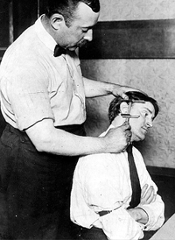
Lombroso’s Theory
Observed the physical characteristics of Italian prisoners and compared them to Italian soldiers
Concluded that criminals were physically different
Lombroso presented a long list of physical characteristics used to identify criminals

Slide 10

In 3000 anthropometric measurements he found some biological traits of criminals.
Biological traits of born criminal are:
unusual size or shape of the head,
strange eyes,
facial asymmetry,
extended jaw and jaw bone,
too big or too small ears,
full lips leaned forward,

Slide 11
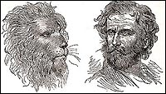
abnormal teeth,
wrinkled skin,
nose curled up;
thief's have a flat nose and murderers have a beak nose,
too long, too small or flat chin,
dark skin and
too long arms.

Slide 12

According to Lombroso, persons who have five or more biological traits are born criminals.
Beside physical traits Lombroso introduces some other traits of born criminal:
1) hypersensitivity on the pain and touch,
2) use of special criminal slang,
3) grotesque expression of thoughts,
4) tattoos and
5) unemployment.

Slide 13
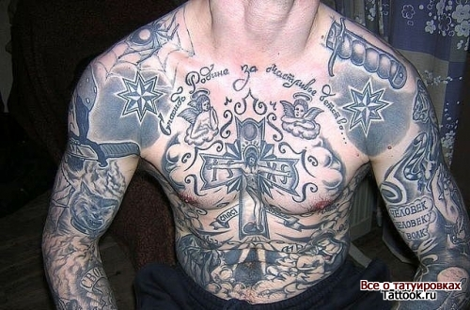
Tattoos
Were significant to Lombroso
Most of the “born criminals” had them
Obscene nature of their depictions and messages
Tattoos stood as evidence of both insensitive to physical pain and immorality

Slide 14
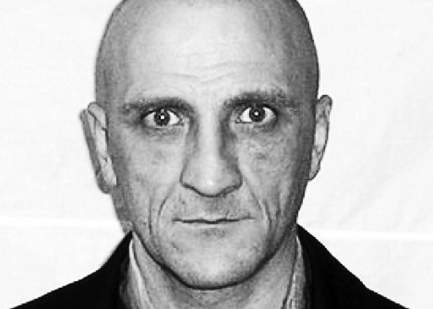
Typical traits of certain types of criminals:
Murderers often have
voluminous cheekbones
huge eye orbits
protruding rectangular chin
goiter and short hands
cold and rigid (glass look
bloodshot eyes
bent downwards (aquiline) nose
overly large or too small earlobes
thin lips

Slide 15
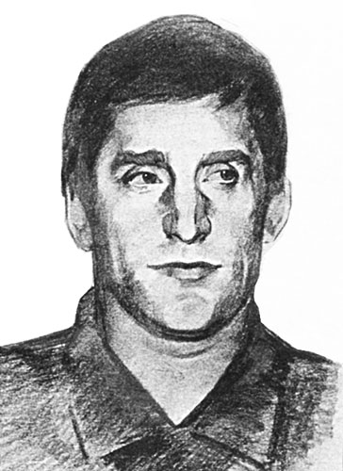
Thieves often have
elongated head
black hair
mental development is higher than that of other offenders ,
nose straight, often concave ,
Eyes and hands moving ( thief avoids meeting with the speaker direct look - rolling eyes ) .

Slide 16
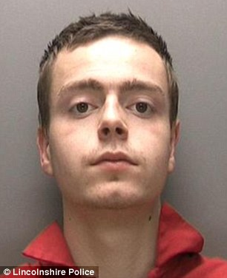
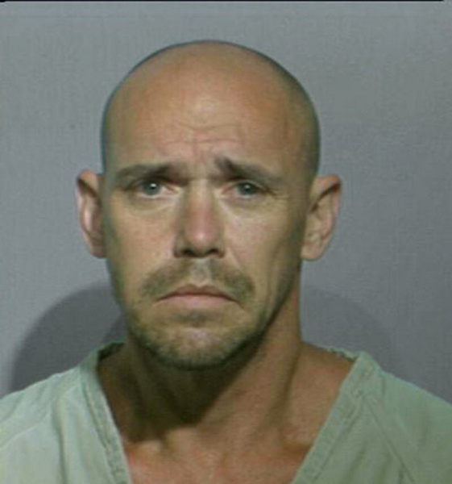
Abusers often have
bulging eyes,
gentle face,
lips and eyelashes are huge,
flattened nose
Fraudsters often have
good-natured appearance,
face pale,
small, harsh eyes
crooked nose,
bald head

Slide 17
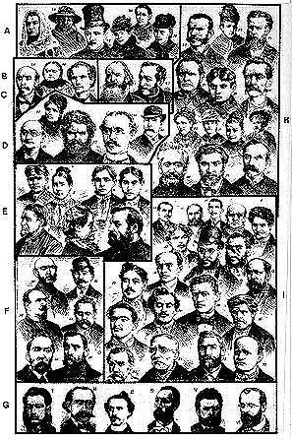
Lombroso claimed that to the trained eye, the eye of the detective, these people would clearly be organized into categories
Those in group
"A" are all shoplifters,
"B" are swindlers,
"H" are purse snatchers, "E" are murderers, etc.
And supposedly you can see a man's real character at a glance.

Slide 18

Lombroso later changes the theory of born criminal and develops a new theory. Classification of criminals is made into three categories:
1) born criminals, (30% of all criminals)
2) abnormal criminals (idiots, imbeciles, paranoids, melancholics, paralytics, epileptics, demented persons, alcoholics and hysterics)
3) occasional criminals
a) criminaloids
b) pseudo criminals
c) criminals out of habit

Slide 19


Criminaloids
had difficulties during their childhood and can occasionally behave delinquently.
Pseudo criminals
are insane persons and those who committed crime in self defense.
Habitual criminals
had a poor education during their childhood or have been in social interaction with criminals.

Slide 20
Further studies of Lombroso's thesis were made by Goring in 1913 and Hooton in 1939.
Goring contests Lombroso's thesis based on the experiment he made on 3000 criminals and non-criminals. Goring didn't find any physical abnormalities or traits on criminals. He criticized Lombroso on the issue of born criminal and found that such thesis is inaccurate as well as dangerous. Goring concluded that no one is criminal until he or she commits a crime.
Hooton confirms Lombroso's thesis based on the research he made on 14000 criminals and 3000 non-criminals from 10 Federal states of U.S

Slide 21
Critique of Lombroso
Theory overlooks the bright and handsome criminals
Theory ignores those who are ugly and live lives of productive and cooperative labor
Theory does not look at the variations over time in crime rates. Since genes change very slowly, there should be a steady rate of crime over the centuries. That is not the case. Crime rates vary dramatically.

Slide 22
Critique of Lombroso
He was studying the very poor - people whose physical development had been affected by poverty, poor nutrition
Not everyone who breaks the law ends up in prison
This type of theorising neglects the idea that there is a "grey area" of criminality - people who commit crimes but who are not caught and therefore not imprisoned.

